Slide 2
An Introduction to Cybersecurity Practices for Manufacturing and the Defense Industrial Base
The Florida Center for Cybersecurity: “Cyber Florida”

Slide 3
Cyber Florida Point of Contact:
Bryan J. Langley
Lead Program Manager
Critical Infrastructure Protection (CIP) Program
Cyber Florida: The Florida Center for Cybersecurity
bjlangley@cyberflorida.org
Today’s Presenter:
Andy Seely
Cyber Florida Consultant
andy@sonador.com
https://www.cyberflorida.org

Slide 4
Today we will …
Cut through the Fear, Uncertainty, and Doubt of Cybersecurity for your company
Build confidence with a three-step process: Examine, Transform, Command
Develop a simple roadmap to fundamental business Cybersecurity practices
Become familiar with Cybersecurity frameworks
Learn about CMMC
Understand the impacts of CMMC to firms in the Defense Industrial Base (DIB)
Build a CMMC high-level roadmap
Learn about no-cost support from Cyber Florida

Slide 5
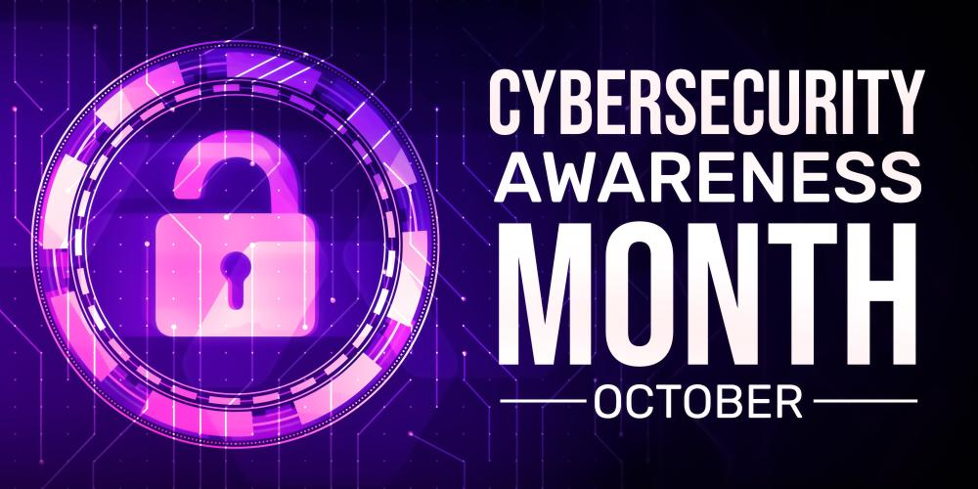
October is…
ADHD Awareness Month
Breast Cancer Awareness Month
Cybersecurity Awareness Month
Domestic Violence Awareness Month
Dwarfism Awareness Month
Filipino-American Heritage Month
My Wife’s Birthday Month
National Book Month
National Vegetarian Month
Soctober
And many others…
https://www.commerce.gov/news/blog/2023/10/national-cybersecurity-month-protecting-yourself-online

Slide 6
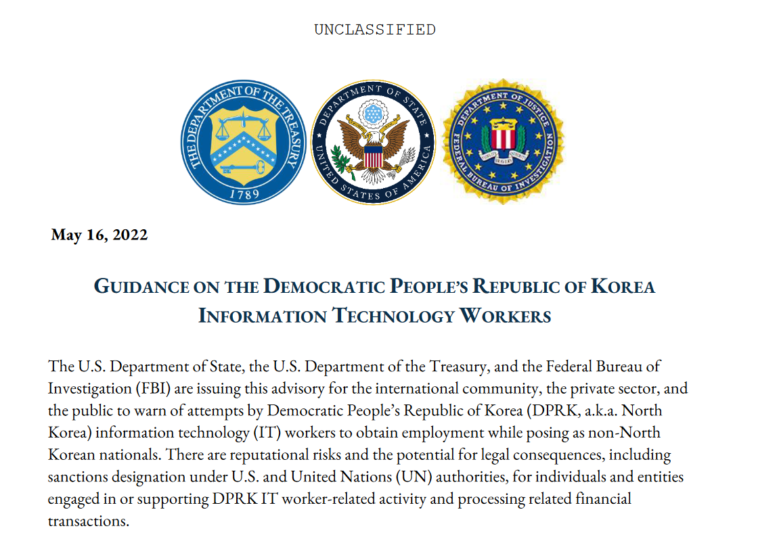
In the news - DPRK
Matthew Isaac Knoot, 38, of Nashville, Tennessee, was arrested today (8 Aug 2024) for his efforts to generate revenue for the Democratic People’s Republic of Korea’s (DPRK or North Korea) illicit weapons program, which includes weapons of mass destruction (WMD).
According to court documents, Knoot participated in a scheme to obtain remote employment with American and British companies for foreign information technology (IT) workers, who were actually North Korean actors. Knoot allegedly assisted them in using a stolen identity to pose as a U.S. citizen; hosted company laptops at his residences; downloaded and installed software without authorization on such laptops to facilitate access and perpetuate the deception; and conspired to launder payments for the remote IT work, including to accounts tied to North Korean and Chinese actors.
https://www.justice.gov/opa/pr/justice-department-disrupts-north-korean-remote-it-worker-fraud-schemes-through-charges-and

Slide 7
In the news - Iran
Since October 2023, Iranian actors have used brute force, such as password spraying, and multifactor authentication (MFA) ‘push bombing’ to compromise user accounts and obtain access to organizations. The actors frequently modified MFA registrations, enabling persistent access. The actors performed discovery on the compromised networks to obtain additional credentials and identify other information that could be used to gain additional points of access. The authoring agencies assess the Iranian actors sell this information on cybercriminal forums to actors who may use the information to conduct additional malicious activity.
https://www.cisa.gov/sites/default/files/2024-10/aa24-290a-iranian-cyber-actors-conduct-brute-force-and-credential-access-activity.pdf

Slide 8
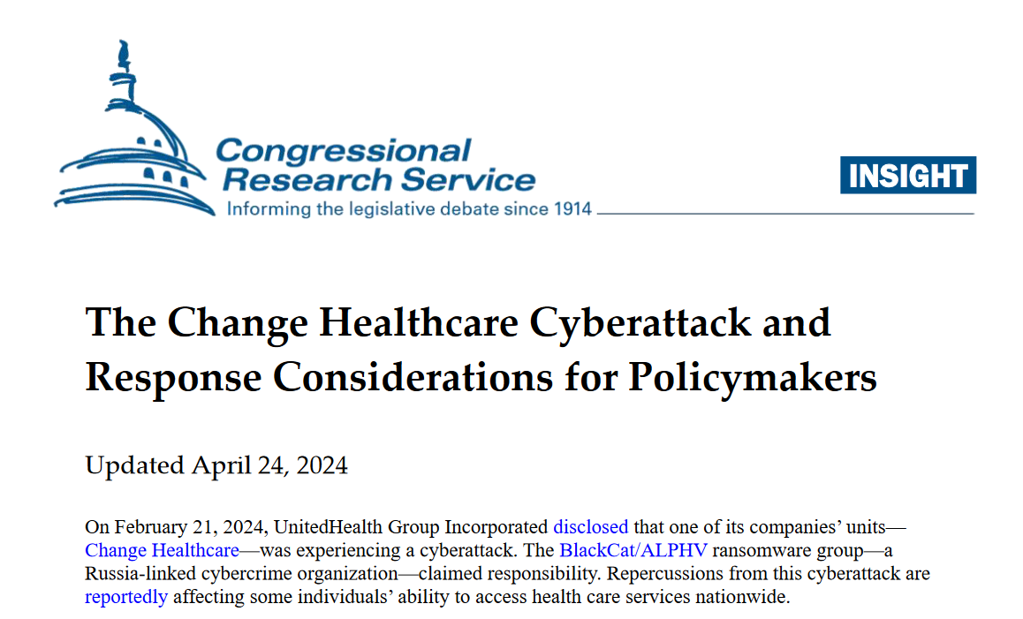
In the news - Russia
A ransomware attack earlier this year on UnitedHealth-owned health tech company Change Healthcare likely stands as one of the largest data breaches of U.S. health and medical data in history.
Months after the February data breach, a “substantial proportion of people living in America” are receiving notice by mail that their personal and health information was stolen by cybercriminals during the cyberattack on Change Healthcare. At least 100 million people are now known to be affected by the breach.
Change Healthcare processes billing and insurance for hundreds of thousands of hospitals, pharmacies and medical practices across the U.S. healthcare sector. As such, it collects and stores vast amounts of highly sensitive medical data on patients in the United States. Through a series of mergers and acquisitions, Change became one of the largest processors of U.S. health data, handling between one-third and one-half of all U.S. health transactions.
https://crsreports.congress.gov/product/pdf/IN/IN12330

Slide 9
You are a Juicy Target for …
Supply chain attacks
Industrial Espionage
Phishing and related attempts
Ransomware
Malware
Denial-of-service
Data exfiltration
Hacktivists | Cyber Criminals | Nation State Actors

Slide 10
Take the Cybersecurity Pop-Quiz
CISO
CISA
MFA
2FA
PII
PHI
HIPAA
SOC2
PCI
SOC
IRP
DLP
TI
SSP
FIPS
NIST
IDS
IPS
SIEM
EDR
XDR
CEH
ISSO
ISSE
IA
CND
ZTA
CMMC
C2M2
CSF
GRC
CIS
CISSP
RMF
ISO
MSSP
CVE
SLA
CSCRM
You know the answer is in here

Slide 11
Are you wondering if your business is up to the challenge?
All the threats, plus all the …
New Cybersecrity Technologies
New Business Processes
New Headcount (Estimated salaries)
CISO – 150k
Security Engineer(s) – 130k each
GRC Analyst(s) – 110k each
SOC Analyst(s) – 95k each
Risk if you don’t do these things?
Reputation loss
Customer loss
Intellectual Property loss
Revenue loss
Budget overruns
Business failure

Slide 12
How are we doing so far?

Slide 13
We just went through “FUD”
Fear - Fed by the infinite cybersecurity dangers you hear about constantly but don’t really understand
Uncertainty – So many concepts to know and requirements to meet, it feels impossible to even get started
Doubt - Is it even possible to do this? Is it worth it? Are consultants going to take all my money? Can my business afford it?

Slide 14
Let’s go through “ETC” instead
Examine your business
Your business goals and risks
Your workforce
Your regulatory requirements
Transform your approach
Choose a path and execute
Methodical adoption
Take Command
People, Process, Tools
Risk and outcomes
Let’s get started…

Slide 15
Baseline Your Business
Clearly document what is important to the business in terms of data, information flow, IT systems, processes, and people.
If you don’t know what’s important, you can’t protect it
Inventory your systems. Every computer, end point, network device, cloud service, by function, operating system, applications, ports and protocols.
If you don’t know what you have, you can’t protect it
Catalog who is in your organization and what functional and cybersecurity skills they have. Document how people in and out of your organization interface with systems and data.
If you don’t know how people use systems and data, you can’t ensure correct access
Review employee salaries and identify any under-compensated personnel.
A source of simmering Insider Threat

Slide 16
Start Some Easy Best Practices Right Now
Create a culture of cybersecurity
Leadership sets the tone, pace, and example
Put someone in charge of cybersecurity today
Initial and recurring cybersecurity awareness training
Set up and encourage “report a cyber issue” - empower staff to feel ownership
Separate business and personal activities on business systems with policy, culture, and enforcement

Slide 17
Start Some Critical Best Practices As Soon As Possible
Separate elevated rights from functional user access
Enable multifactor authentication
Enforce password length, complexity, and age policies
Review and update (or create) IT systems documentation
Review (or deploy) anti-virus and firewall at endpoints
Review and test (or create) IT backup and recovery processes as part of your business continuity

Slide 18
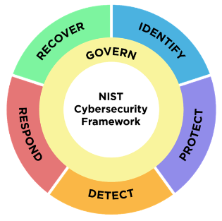
Adopt a Framework
Making this decision is easier if you’re in a regulated or well-defined industry sector. If you’re not, then choose what makes the most sense to implement and has the most resources available.
Specific to an industry?
DoD: CMMC
DoE: C2M2
HIPAA: HITRUST
Finance: SOX
Commerce: PCI DSS
Others…
Not specific to an industry?
NIST CSF
COBIT
SOC2
CIS
ISO
Others…

Slide 19
Gather Resources
Invest in your workforce
Training
Staffing
Consultants
Invest in the right tools
Network defense
Compliance and reporting
Continuous monitoring
Cyber insurance
Choose or upgrade your Managed Services MSP, MSSP

Slide 20
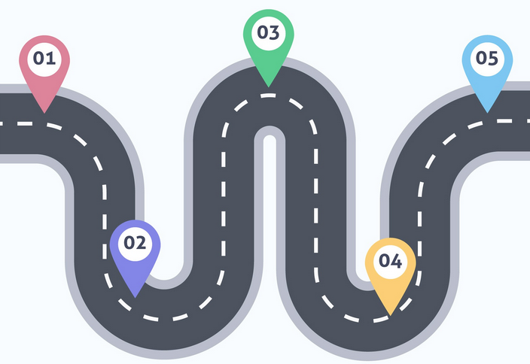
Make a Long-Term Roadmap
You can’t do it all at once, so make a crawl-walk-run plan
Establish metrics, measurements, and reporting culture
Celebrate small wins
Recognize people
Reward progress
Align with your chosen framework’s implementation plans

Slide 21
FUD
ETC
Taking Control…

Slide 22
Answers to the quiz
CISO – Chief Information Security Officer
CISA – Cybersecurity and Infrastructure Security Agency
MFA – Multi Factor Authentication
2FA – Two Factor Authentication
PII – Personally Identifiable Information
PHI – Protected Health Information
HIPAA – Health Insurance Portability and Accountability Act
SOC2 – System and Organization Controls Type 2
PCI – Payment Card Industry
SOC – Security Operations Center
IRP – Incident Response Plan
DLP – Data Loss Prevention
TI – Threat Intelligence
SSP – System Security Plan
FIPS – Federal Information Processing Standards
NIST – National Institute for Science and Technology
IDS – Intrusion Detection System
IPS – Intrusion Prevention System
SIEM – Security Information and Event Management
EDR – Endpoint Detection and Response
XDR – Extended Detection and Response
CEH – Certified Ethical Hacker
ISSO – Information System Security Officer
ISSE – Information System Security Engineer
IA – Information Assurance
CND – Computer Network Defense
ZTA – Zero Trust Architecture
CMMC – Cybersecurity Maturity Model Certification
C2M2 – Cybersecurity Capability Maturity Model
CSF – Cybersecurity Framework
GRC – Governance Risk and Compliance
CIS – Center for Internet Security
CISSP – Certified Information Systems Security Professional
RMF – Risk Management Framework
ISO – International Standards Organization
MSSP – Managed Security Service Provider
CVE – Common Vulnerabilities and Exposures
SLA – Service Level Agreement
CSCRM – Cybersecurity Supply Chain Risk Management

Slide 23
CMMC For DIB Manufacturers

Slide 24
If you only have time for one slide
CMMC is a program for ensuring contractor protections of Federal Contract Information (FCI) and Controlled Unclassified Information (CUI).
CMMC 2.0 is an enforcement of NIST SP 800-171/171A/172 and is a burden.
CMMC is a contract requirement. If your contract doesn’t include DFARS 252.204-7021 today then you don’t have a CMMC requirement in your current contract.
Defense contracts already require NIST SP 800-171 compliance via DFARS 252.204-7012. Federal contracts require cybersecurity hygiene via FAR 52.204-21.
CMMC 2.0 compliance will be required for all new Defense contracts with a phased roll-out over three years-- compliance will be required in order to submit a bid for new contracts. Start now: Scope, staffing, gap analysis, remediation, assessment.
CMMC 2.0 Level 1 is a self-assessment focused on 15 requirements for FCI protections.
CMMC 2.0 Level 2 is a 3rd party assessment focused on 110 requirements for FCI and CUI defined in NIST SP 800-171r2 and SP 800-171A
CMMC 2.0 Level 3 is a government-run assessment focused on 110 requirements for FCI, CUI, AND advanced guidance from NIST SP 800-172.

Slide 25
CMMC at a Glance
Cybersecurity Maturity Model Certification (CMMC) is a formal framework for accountability of a contractor’s cybersecurity hygiene.
CMMC enforces compliance of NIST SP 800-171, SP 800-171A, SP 800-172 on contractor-owned systems.
Applies to contractor’s own systems where Federal Contract Information (FCI) and Controlled Unclassified Information (CUI) are processed.
Does not apply to government-owned systems operated by contractors and managed via RMF and NIST SP 800-53.
NIST defines the details for CUI cybersecurity hygiene.
DoD CIO defines the CMMC program to implement the NIST details.
OUSD A&S defines the requirement to comply with the CMMC program.
Cyber AB defines who is qualified to certify CMMC program compliance.
You achieve CMMC certification and win work with DoD !
https://dodcio.defense.gov/CMMC/
Notes:
CMMC applies to your company’s systems, not government-owned systems.
Lower right shows how CMMC is built up from details to requirement to compliance.

Slide 26
Why CMMC? Why Now?
The DIB is a popular attack vector to get at the DoD.
Intellectual Property theft damages U.S. economy and erodes U.S. competitive advantage.
Continues increased cybersecurity hardening trends following RMF, NIST SP 800-171, and DFARS 252.204-712.
Streamlines and standardizes cybersecurity practices across the DIB to create a common baseline.
Aligns with broader Federal efforts to protect Critical Infrastructure and sensitive Federal data.
Reduces DoD cybersecurity risk for complex supply chains and vendor relationships.

Slide 27
CMMC applies to you if you…
Process, store, or transmit information that meets the definition of FCI or CUI on contractor information systems as part of an awarded prime or subcontract.
This is true regardless of the size or purpose of your company.
CMMC will not apply if your company provides services to operate and maintain government-owned networks.
Contracts or orders that are exclusively for commercial off-the-shelf (COTS) items or are valued at or below the micro-purchase threshold do not require CMMC.
*** If your company processes FCI on your company network as a function of selling COTS, then CMMC Level 1 DOES apply ***
When in doubt, check your contract!
Notes:
FCI, CUI, and contracts.

Slide 28
A Quick Look at Relevant Contract Language
FAR 52.204-21
DFARS 252.204-7012
DFARS 252.204-7019
DFARS 252.204-7021
CFR 32 National Defense
CFR 48 Federal Acquisition Regulations System
Notes:
CMMC requirements are in contracts. I’ll show you relevant contract language so you can recognize it.

Slide 29
FAR 52.204-21
Basic Safeguarding of Covered Contractor Information Systems.
(1) The Contractor shall apply the following basic safeguarding requirements and procedures to protect covered contractor information systems. Requirements and procedures for basic safeguarding of covered contractor information systems shall include, at a minimum, the following security controls:
(i) Limit information system access to authorized users, processes acting on behalf of authorized users, or devices (including other information systems).
(ii) Limit information system access to the types of transactions and functions that authorized users are permitted to execute.
(x) Monitor, control, and protect organizational communications (i.e., information transmitted or received by organizational information systems) at the external boundaries and key internal boundaries of the information systems.
(xi) Implement subnetworks for publicly accessible system components that are physically or logically separated from internal networks.
(xii) Identify, report, and correct information and information system flaws in a timely manner.
(xiii) Provide protection from malicious code at appropriate locations within organizational information systems.
(xiv) Update malicious code protection mechanisms when new releases are available.
(xv) Perform periodic scans of the information system and real-time scans of files from external sources as files are downloaded, opened, or executed.
https://www.acquisition.gov/far/52.204-21
Notes:
FAR part 52 in federal contracts includes provisions for security, including 52.204-21, which outlines expectations for protecting covered contractor information systems.

Slide 30
DFARS 252.204-7012
(2) For covered contractor information systems that are not part of an IT service or system operated on behalf of the Government and therefore are not subject to the security requirement specified at paragraph (b)(1) of this clause, the following security requirements apply:
(i) Except as provided in paragraph (b)(2)(ii) of this clause, the covered contractor information system shall be subject to the security requirements in National Institute of Standards and Technology (NIST) Special Publication (SP) 800-171, “Protecting Controlled Unclassified Information in Nonfederal Information Systems and Organizations” (available via the internet at http://dx.doi.org/10.6028/NIST.SP.800-171) in effect at the time the solicitation is issued or as authorized by the Contracting Officer.
DFARS 7012 directs the contractor to implement NIST 800-171, build a System Security Plan (SSP) that describes how you have implemented NIST 800-171, create a Plan of Action and Milestones (POA&M) that describes where you have not yet implemented NIST 800-171 as well as how and when you plan to meet its requirements, create an incident response plan (IRP), and other requirements.
Note that you can be compliant with DFARS 7012 even if you have not yet implemented all 110 controls in NIST 800-171. The POA&M provides some flexibility.
https://www.acquisition.gov/dfars/252.204-7012-safeguarding-covered-defense-information-and-cyber-incident-reporting.
Notes:
In defense contracts, DFARS takes the FAR clause farther and directs compliance with 800-171, including SSP, POA&M, IRP, etc. You have to be compliant with these provisions, but there’s no program for verifying compliance over time.

Slide 31
What About Cloud?
From DFARS 252.204-7012:
(D) If the Contractor intends to use an external cloud service provider to store, process, or transmit any covered defense information in performance of this contract, the Contractor shall require and ensure that the cloud service provider meets security requirements equivalent to those established by the Government for the Federal Risk and Authorization Management Program (FedRAMP) Moderate baseline (https://www.fedramp.gov/documents-templates/) and that the cloud service provider complies with requirements in paragraphs (c) through (g) of this clause for cyber incident reporting, malicious software, media preservation and protection, access to additional information and equipment necessary for forensic analysis, and cyber incident damage assessment.
https://www.acquisition.gov/dfars/252.204-7012-safeguarding-covered-defense-information-and-cyber-incident-reporting.
Notes:
If you use public cloud, your security boundary includes those cloud services. For 252.204-7012 this calls for FedRAMP Moderate services. If you’re not paying extra for a government cloud then you probably aren’t here.

Slide 32
DFARS 252.204-7019 pairs with 252.204-7012
NOTICE OF NIST SP 800–171 DOD ASSESSMENT REQUIREMENTS (NOV 2023)
(a) Definitions.
“Basic Assessment”, “Medium Assessment”, and “High Assessment” have the meaning given in the clause 252.204-7020, NIST SP 800-171 DoD Assessments.
“Covered contractor information system” has the meaning given in the clause 252.204-7012, Safeguarding Covered Defense Information and Cyber Incident Reporting, of this solicitation.
(b) Requirement. In order to be considered for award, if the Offeror is required to implement NIST SP 800–171, the Offeror shall have a current assessment ( i.e., not more than 3 years old unless a lesser time is specified in the solicitation) (see 252.204–7020) for each covered contractor information system that is relevant to the offer, contract, task order, or delivery order. The Basic, Medium, and High NIST SP 800–171 DoD Assessments are described in the NIST SP 800–171 DoD Assessment Methodology located at https://www.acq.osd.mil/asda/dpc/cp/cyber/docs/safeguarding/NIST-SP-800-171-Assessment-Methodology-Version-1.2.1-6.24.2020.pdf ..
https://www.acquisition.gov/dfars/252.204-7019-notice-nistsp-800-171-dod-assessment-requirements.
Notes:
The 7019 clause directs this assessment for contracts implementing 7012. It is a self-assessment.

Slide 33
DFARS 252.204-7021
CYBERSECURITY MATURITY MODEL CERTIFICATION REQUIREMENTS (JAN 2023)
Scope. The Cybersecurity Maturity Model Certification (CMMC) CMMC is a framework that measures a contractor’s cybersecurity maturity to include the implementation of cybersecurity practices and institutionalization of processes
Requirements. The Contractor shall have a current (i.e. not older than 3 years) CMMC certificate at the CMMC level required by this contract and maintain the CMMC certificate at the required level for the duration of the contract.
Subcontracts. The Contractor shall—
(1) Insert the substance of this clause, including this paragraph (c), in all subcontracts and other contractual instruments, including subcontracts for the acquisition of commercial products or commercial services, excluding commercially available off-the-shelf items; and
(2) Prior to awarding to a subcontractor, ensure that the subcontractor has a current (i.e., not older than 3 years) CMMC certificate at the CMMC level that is appropriate for the information that is being flowed down to the subcontractor.
https://www.acquisition.gov/dfars/252.204-7021-cybersecurity-maturity-model-certification-requirements.
Notes:
The new DFARS clause, 252.204-7021 explicitly calls for CMMC compliance.
Prior to award. If you state in a bid that you will achieve by award, I think that creates contract risk for the government.
Note subcontractors are also impacted.

Slide 34
CFR Title 32 Subtitle B Chapter XX Part 2002 “Final Rule”
The CUI Program standardizes the way the executive branch handles information that requires protection under laws, regulations, or Government-wide policies, but that does not qualify as classified under Executive Order 13526
All unclassified information throughout the executive branch that requires any safeguarding or dissemination control is CUI
Protecting CUI under the control of an authorized holder. Authorized holders must take reasonable precautions to guard against unauthorized disclosure of CUI. They must include the following measures among the reasonable precautions … Establish controlled environments in which to protect CUI from unauthorized access or disclosure and make use of those controlled environments;
Information systems that process, store, or transmit CUI. In accordance with FIPS PUB 199 CUI Basic is categorized at no less than the moderate confidentiality impact level. FIPS PUB 199 defines the security impact levels for Federal information and Federal information systems.
Agencies must use NIST SP 800-171 when establishing security requirements to protect CUI's confidentiality on non-Federal information systems (unless the authorizing law, regulation, or Government-wide policy listed in the CUI Registry for the CUI category or subcategory of the information involved prescribes specific safeguarding requirements for protecting the information's confidentiality, or unless an agreement establishes requirements to protect CUI Basic at higher than moderate confidentiality)
https://www.ecfr.gov/current/title-32/subtitle-B/chapter-XX/part-2002

Slide 35
CFR Title 48 Chapter 2 Subchapter A Part 204 Subpart 204.75
This subpart prescribes policies and procedures for including the Cybersecurity Maturity Model Certification (CMMC) level requirements in DoD contracts. CMMC is a framework that measures a contractor's cybersecurity maturity to include the implementation of cybersecurity practices and institutionalization of processes
The contracting officer shall include in the solicitation the required CMMC level, if provided by the requiring activity. Contracting officers shall not award a contract, task order, or delivery order to an offeror that does not have a current (i.e., not more than 3 years old) CMMC certificate at the level required by the solicitation.
The contracting officer shall include in the solicitation the required CMMC level, if provided by the requiring activity. Contracting officers shall not award a contract, task order, or delivery order to an offeror that does not have a current (i.e., not more than 3 years old) CMMC certificate at the level required by the solicitation.
Contracting officers shall use Supplier Performance Risk System (SPRS) (https://www.sprs.csd.disa.mil/) to verify an offeror or contractor's CMMC level
Use the clause at 252.204-7021, Contractor Compliance with the Cybersecurity Maturity Model Certification Level Requirement, as follows: On or after October 1, 2025, in all solicitations and contracts or task orders or delivery orders, including those using FAR part 12 procedures for the acquisition of commercial products and commercial services, except for solicitations and contracts or orders solely for the acquisition of COTS items.
https://www.ecfr.gov/current/title-48/chapter-2/subchapter-A/part-204/subpart-204.75

Slide 36
A Look at CUI, NIST SP 800-171, and CMMC Levels

Slide 37
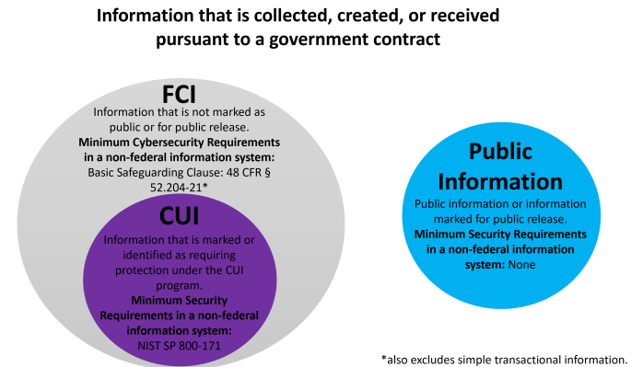
Defining CUI
The National Archives and Records Administration (NARA) serves as the Controlled Unclassified Information (CUI) Program's Executive Agent and has delegated CUI Executive Agent responsibilities to the Director of the Information Security Oversight Office (ISOO). As the CUI Executive Agent, ISOO issues guidance to Federal agencies on safeguarding and marking CUI.
https://www.archives.gov/guidance/cui-guidance
https://isoo.blogs.archives.gov/2020/06/19/%E2%80%8Bfci-and-cui-what-is-the-difference/
Notes:
This might be a little bit in the weeds for many of you, but if you’re curious about the definition of CUI and FCI, NARA is the responsible agency for these definitions.
This citation of Code of Federal Regulations 48 for FCI actually is the FAR language I introduced earlier.

Slide 38
Defining CUI
Each organizational index has one or more specific CUI categories. For example, Defense includes:
Controlled Technical Information
DoD Critical Infrastructure Security Information
Privileged Safety Information
Naval Nuclear Propulsion Information
Unclassified Controlled Nuclear Information – Defense
CUI categories are grouped by organizational indices:
Critical Infrastructure
Defense
Export Control
Financial
Immigration
Intelligence
International Agreements
Law Enforcement
Legal
Natural and Cultural Resources
NATO
Nuclear
Patent
Privacy
Procurement and Acquisition
Proprietary Business Information
Provisional
Statistical
Tax
Transportation
https://www.archives.gov/cui/registry/category-list
Notes:
These 20 groupings are pretty broad, and each is broken down into categories such as these five for defense. It’s likely that the majority of us in this call will deal with the first two or three categories of information.

Slide 39
NIST SP 800-171
“The protection of Controlled Unclassified Information (CUI) resident in nonfederal systems and organizations is of paramount importance to federal agencies and can directly impact the ability of the federal government to successfully conduct its essential missions and functions. This publication provides agencies with recommended security requirements for protecting the confidentiality of CUI when the information is resident in nonfederal systems and organizations; when the nonfederal organization is not collecting or maintaining information on behalf of a federal agency or using or operating a system on behalf of an agency; and where there are no specific safeguarding requirements for protecting the confidentiality of CUI prescribed by the authorizing law, regulation, or governmentwide policy for the CUI category listed in the CUI Registry. The requirements apply to all components of nonfederal systems and organizations that process, store, and/or transmit CUI, or that provide protection for such components. The security requirements are intended for use by federal agencies in contractual vehicles or other agreements established between those agencies and nonfederal organizations.”
https://csrc.nist.gov/pubs/sp/800/171/r3/final
Notes:
NIST SP 800-171 gets talked about a lot. Note that it governs non-federal systems and defines requirements for working with CUI. The current revision is r3. CMMC 2.0 requires r2.

Slide 40
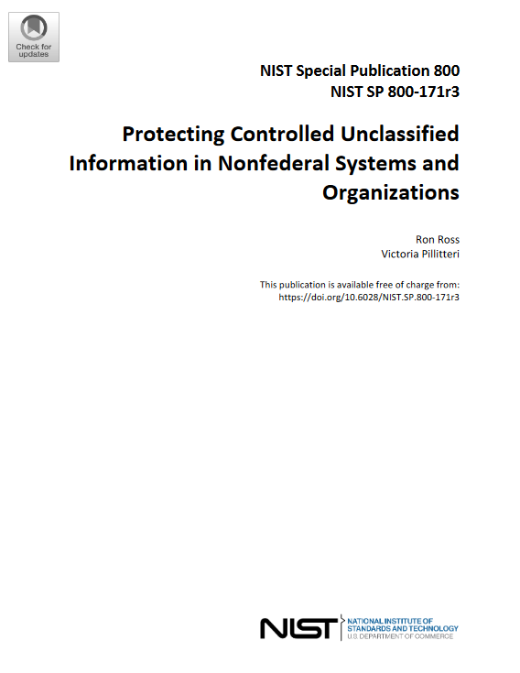
NIST SP 800-171
110 controls in 17 control families
Access Control
Awareness and Training
Audit and Accountability
Assessment, Authorization and Monitoring
Configuration Management
Identification and Authentication
Incident Response
Maintenance
Media Protection
Physical and Environmental Protection
Planning
Personnel Security
Risk Assessment
System and Services Acquisition
System and Communications Protection
System and Information Integrity
Supply Chain Risk Management
https://csrc.nist.gov/pubs/sp/800/171/r3/final
Notes:
171 describes these 17 families of controls, and each family is made up of specific controls. CMMC level 2 compliance requires being compliant with all 110 controls.

Slide 41
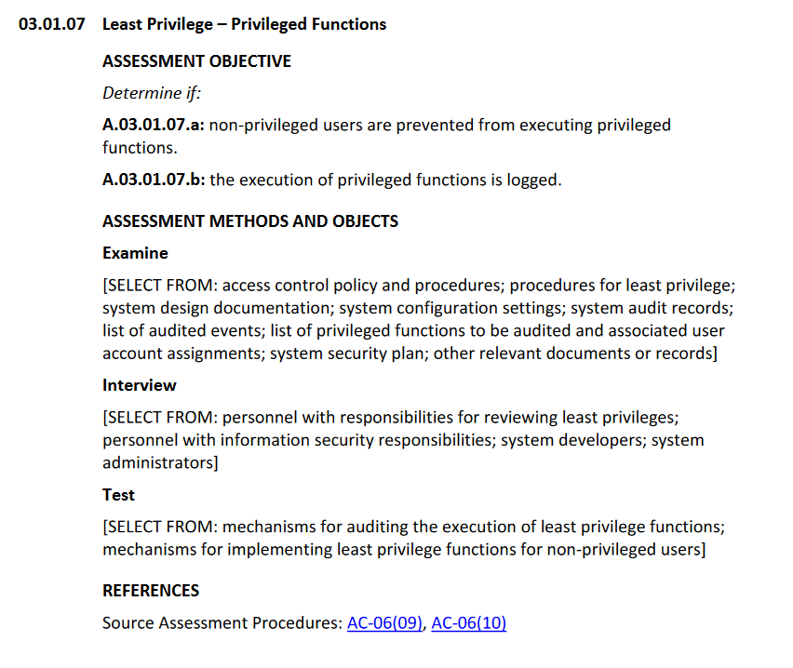
NIST SP 800-171A
This publication provides organizations with assessment procedures and a methodology that can be used to conduct assessments of the security requirements in NIST Special Publication 800-171, Protecting Controlled Unclassified Information in Nonfederal Systems and Organizations. The assessment procedures are flexible and can be customized to the needs of organizations and assessors. Assessments can be conducted as independent, third-party assessments or as government-sponsored assessments.
320 assessment objectives for 110 controls in 17 control families
https://csrc.nist.gov/pubs/sp/800/171/a/r3/final
Notes:
171A adds an additional 320 assessment objectives to compliance with 171. This is in-scope for a CMMC level 2 effort.

Slide 42
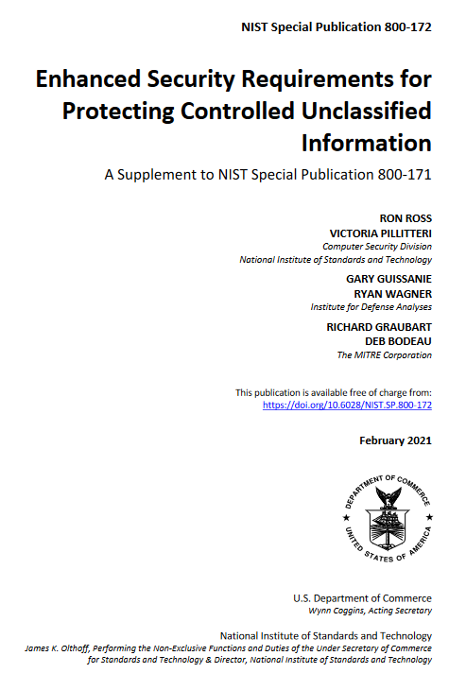
NIST SP 800-172
“In certain situations, CUI may be associated with a critical program or a high value asset. These critical programs and high value assets are potential targets for the advanced persistent threat (APT). An APT is an adversary or adversarial group that possesses the expertise and resources that allow it to create opportunities to achieve its objectives by using multiple attack vectors, including cyber, physical, and deception. The APT objectives include establishing a foothold within the infrastructure of targeted organizations for purposes of exfiltrating information; undermining or impeding critical aspects of a mission, function, program, or organization; or positioning itself to carry out these objectives in the future. The APT pursues its objectives repeatedly over an extended period, adapts to defenders’ efforts to resist it, and is determined to maintain the level of interaction needed to execute its objectives. While the category of CUI itself does not require greater protection, CUI associated with critical programs or high value assets is at greater risk because the APT is more likely to target such information and therefore requires additional protection.”
https://csrc.nist.gov/Pubs/sp/800/172/Final
Notes:
We won’t cover CMMC level 3 in this brief, as the rules have not really been settled. But in general, level 3 will require compliance with 171, 171A, and 172. This will include requirements for penetration testing. As I understand it, level 3 will be required for contractors working on things like weapons systems.

Slide 43
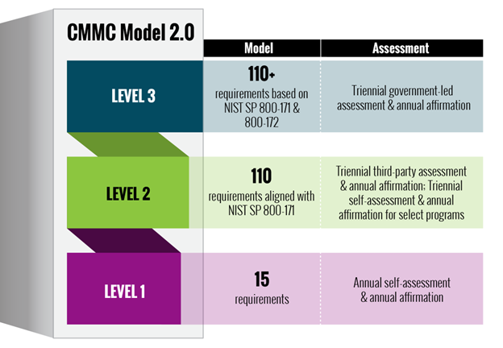
CMMC Levels
Cybersecurity Maturity Model Certification (CMMC) Model Overview https://dodcio.defense.gov/Portals/0/Documents/CMMC/ModelOverview_V2.0_FINAL2_20211202_508.pdf
Level 1 (17 practices). An organization must demonstrate basic cyber hygiene practices to protect Federal Contract Information (FCI).
Level 2 (110 practices). An organization must have an institutionalized management plan to implement good cyber hygiene practices to safeguard CUI, including 110 NIST 800-171 r2 controls and 320 800-171A objectives.
Level 3 (Optimizing 110+ practices). An organization must have standardized and optimized processes in place and additional enhanced practices that detect and respond to changing tactics, techniques and procedures (TTPs) of advanced persistent threats (APTs). Implements NIST 800-172.
17
https://dodcio.defense.gov/CMMC/Model/
Notes:
We’ve set the stage with understanding contract language, the definitions of CUI, and the important NIST publications. Now we can talk about CMMC itself.
The DoD CIO link at the bottom is an excellent starting point. There’s a note on the site that updates are paused pending review of the 2.0 rules by congress.
Three levels for CMMC. Level 1 is a self-assessment of 17 controls. Level 2 is a 3rd party assessment of 110 controls. Level 3 is an assessment conducted directly by the government.
Remember, CMMC 2.0 uses 171 R2, even though R3 is current.

Slide 44
CMMC Level 1
Limited to these controls:
AC: AC.L1-3.1.1, AC.L1-3.1.2, AC.L1-3.1.20, AC.L1-3.1.22
IA: IA.L1-3.5.1, IA.L1-3.5.2
MP: MP.L1-3.8.3
PE: PE.L1-3.10.1, PE.L1-3.10.3, PE.L1-3.10.4, PE.L1-3.10.5
SC: SC.L1-3.13.1, SC.L1-3.13.5
SI: SI.L1-3.14.1, SI.L1-3.14.2, SI.L1-3.14.4, SI.L1-3.14.5
CMMC Self Assessment Scope – level 1
https://dodcio.defense.gov/Portals/0/Documents/CMMC/Scope_Level1_V2.0_FINAL_20211202_508.pdf
CMMC Self-Assessment Guide - level 1
https://dodcio.defense.gov/Portals/0/Documents/CMMC/AssessmentGuideL1v2.pdf
Results are documented in SSP and POA&M, self-reported in Supplier Performance Risk System.
Notes:
These documents are a little dated but still the current guidance for scoping and conducting a level 1 assessment.
According to the Cyber AB town hall last night, updated CMMC Assessment Process documentation is expected by labor day this year.
You conduct your self-assessment and document your status in SPRS.

Slide 45
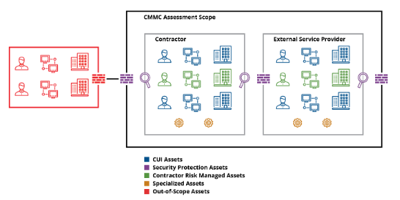
CMMC Level 2
CMMC Assessment Scope - Level 2
https://dodcio.defense.gov/Portals/0/Documents/CMMC/Scope_Level2_V2.0_FINAL_20211202_508.pdf
CMMC Assessment Guide - Level 2
https://dodcio.defense.gov/Portals/0/Documents/CMMC/AssessmentGuideL2.pdf
Results are documented in eMASS, SPRS, and a CMMC Certificate provided by the C3PAO.
“Certified Assessors will use the assessment methods as defined in this guide to conduct CMMC Level 2 assessments. Certified Assessors will review information and evidence to independently verify that a contractor meets the stated assessment objectives for all of the required practices.”
Notes:
CMMC Level 2 will require a C3PAO to conduct the assessment and provide a certification of compliance.
An organization expecting to go through this process would want to start with the assessment scope and guide and make a plan to achieve compliance before hiring a C3PAO. You can hire outside help, but note that you can’t hire the C3PAO you use for the assessment to help you prepare for the assessment.

Slide 46
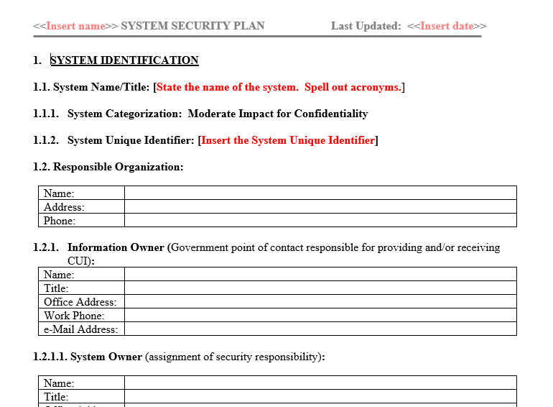
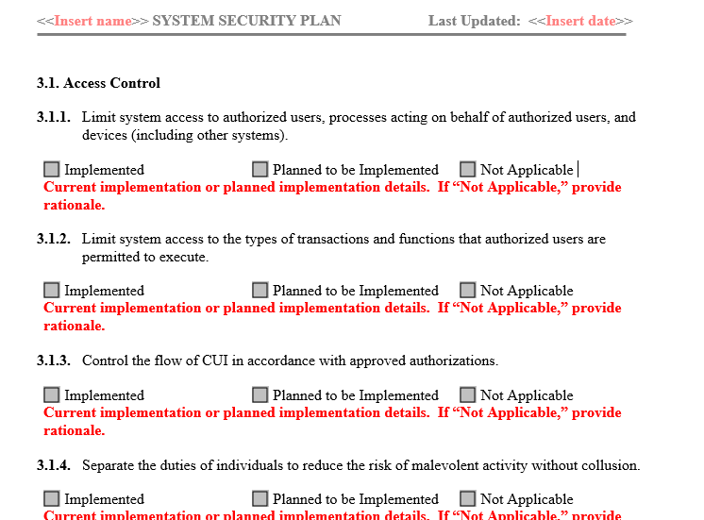
Role of System Security Plan in CMMC
The SSP is essential for CMMC. It describes the CUI protection program and enumerates each of the SP 800-171 controls. SP 800-171A should guide the minimum SSP requirements.
It’s common to have a 200~300 page SSP. If your SSP is under 100 pages you might be lacking sufficient detail.
The SSP will be supported by additional documents like an IRP.
The SSP itself is CUI, in the Security Protection Data category.
NIST offers an SSP template as a starting point.
https://csrc.nist.gov/files/pubs/sp/800/171/r2/upd1/final/docs/cui-ssp-template-final.docx
Notes:
If you’re starting from scratch, the NIST template is a nice starting point. They key for CMMC success will be a laboriously-detailed SSP. The SSP demonstrates your understanding of each required control and presents evidence of compliance. The less evidence you have, the deeper your C3PAO will have to dig. I would expect the existence of a good SSP will help reduce the cost estimate from your C3PAO.

Slide 47
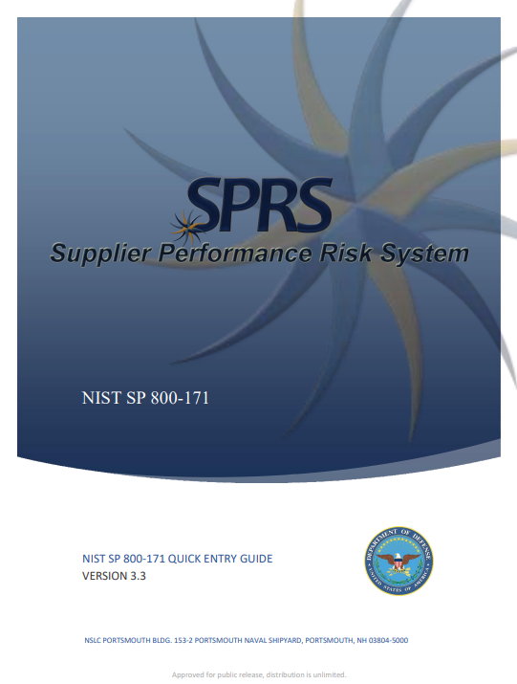
Supplier Performance Risk System
SPRS is the system used to report compliance with NIST SP 800-171 and CMMC.
CMMC Level 2 will be automatically reported to SPRS via eMASS, with data provided by your C3PAO
Example language from a recent GSA Alliant II Task Order Request:
This Quick Entry Guide provided by DISA is from August 2021, gives screen shots and step by step for setting up and submitting assessment results.
https://www.sprs.csd.disa.mil/pdf/NISTSP800-171QuickEntryGuide.pdf
Notes:
If you haven’t had to use SPRS before, DISA has a very nice and surprisingly concise quick start guide.
Note the contract language, this one pulled from an Alliant contract last year that called for a DFARS 204-7019 self assessment.

Slide 48
Timelines, Paths to Certification, and Cost
Notes:
When, how, and how much?!

Slide 49
A Key Note:
Don’t spend money you don’t need to spend
Vet your vendors
Get a gap analysis
Do a self assessment
Understand your contract requirements
Ensure your C3PAO is certified
Build your organic cybersecurity workforce
Path to and Problems with Certification
When to start? Now. Yesterday, if possible.
Some estimates suggest that NIST SP 800-171 implementation for 50-100 person companies starting from scratch will average 12-18 months
Required for new contracts THIS YEAR … the heat is on!
Significant DIB criticism that CMMC is an undue burden on small businesses (and on large businesses)
If you do not have a robust cybersecurity team, get help!
There are a LOT of companies selling help – due diligence is important
Start with scoping
Do a gap analysis
Perform a self assessment
Certified 3rd Party Assessment Organization (C3PAO) required to issue a CMMC Level 2 certification
Check the listing in the CMMC AB Marketplace: https://cyberab.org/Catalog#!/c/s/Results/Format/list/Page/1/Size/9/Sort/NameAscending?term=tampa
The Cyber AB is the official accrediting body for CMMC assessors
Notes:
There are a lot of estimates of timing, time it will take, and cost, and they vary greatly. As CMMC moves through the rule-making process, expect those estimates to start coalescing.
You have time to get CMMC-ready before it’s firmly required by contracts. You may get prime-contractor pressures before then.
The Cyber Accreditation Board is an essential piece of the puzzle. They are the authorized body to approve who is qualified to do assessments and who can issue certifications.
You can hire people to help who are not in the Cyber AB marketplace, but practice due diligence on their background, experience, and approach.

Slide 50
Cyber AB and CMMC Roles
The Cyber AB is the official accreditation body of the Cybersecurity Maturity Model Certification (CMMC) Ecosystem and the sole authorized non-governmental partner of the U.S. Department of Defense in implementing and overseeing the CMMC conformance regime. https://cyberab.org/
Registered Practitioner (RP): An individual who has attended training and passed tests demonstrating knowledge of CMMC levels. Valuable for preparation and consulting. Can help with self-assessment. Can not provide CMMC certification or letter of attestation.
Registered Practitioner Organization (RPO): An organization that provides RP personnel for consulting and non-certified advisory roles.
Certified CMMC Professional (CCP): Has been trained, evaluated, and authorized to provide certifications for CMMC Level 1. While Level 1 is self-assessment, a CCP providing that assessment may add additional value to an organization.
Certified CMMC Assessor (CCA): Has been trained, evaluated, and authorized to provide certifications for CMMC Level 2. Only a CCA may provide this certification service.
CMMC 3rd Party Assessment Organization (C3PAO): A company that employes CCA and CCP personnel to conduct independent assessments and provide CMMC certifications.
Note that an RP, CCP, or CCA who assists an organization in preparation for an assessment may not also participate in that assessment.
Notes:
The RP, CCP, and CCA are roles an individual earns through training and evaluation with Cyber AB.
The RPO and C3PAO are organizations who employ RP, CCP, and CCA personnel to provide services to contract companies seeking CMMC certification.
You can’t have the same people help you prepare for an assessment and then perform the assessment.

Slide 51
Cyber AB Assessors
Find accredited assessors: https://cyberab.org/Catalog
Notes:
This chart is a nice view of how the CCP and CCA roles are developed. Will help inform your decision-making as you vet assessors

Slide 52
CMMC Timeline
Mid 2022 – 20 C3PAOs “authorized,” but cannot yet perform CMMC assessments.
Mid 2022 – Mid 2023: A few C3PAOs were allowed to do “joint voluntary” assessments of 800-171 alongside the Defense Industrial Base Cybersecurity Assessment Center (DIBCAC). These are not CMMC assessments.
Mid 2022 – About 100 CMMC Assessors certified but cannot yet perform CMMC assessments.
Late 2023 – New DFARS rule enforcing CMMC was published in draft. 26 December DoD submitted the proposed rule for CMMC 2.0 to the Federal Register.
27 June: DoD submitted CMMC 2.0 under Title 32 (National Defense) to Information and Regulatory Affairs in OMB
October 2024: CFR 32 finalized
December 2024: CFR 48 finalized
Mid 2025 – contracts requiring CMMC Level 1 self-assessment released.
Late 2025 – 3 year phased rollout of DFARS 2021 contracts requiring CMMC Level 2 certification assessments
Mid 2026 – contracts requiring CMMC Level 3 certification assessments released.
Impacts your business
https://www.cmmcaudit.org/

Slide 53
CMMC Roadmap for FloridaMakes Members
Assess current (and future) contracts and subcontracts for 7012, 7019, 7021 language
CUI survey and data flow scoping
Documentation review WRT NIST 800-171
Build an approach (possibly hire an RP)
Decision: In-house, managed service, hybrid
Decision: Whole enterprise or enclave
Self assessment and recovery
Gap assessment and recovery
C3PAO assessment
CMMC Certification to SPRS via eMASS
Do lots of business
https://www.cmmcaudit.org/

Slide 54
The Cost of CMMC
“DoD's Office of Small Business and Technology Partnerships (OSBTP) is working to provide SBIR/STTR programs with support for CMMC implementation through the use of Technical and Business Assistance. The SBA's affiliation rules are codified at 13 CFR 121.103, available at https://www.ecfr.gov/​current/​title-13/​chapter-I/​part-121.Any change to the SBA's affiliation rules is outside the scope of this rulemaking.” (There is no obvious mention of this assistance in https://business.defense.gov/)
https://www.federalregister.gov/documents/2023/12/26/2023-27280/cybersecurity-maturity-model-certification-cmmc-program
“A Level 2 self-assessment and related affirmations are estimated to cost over $37,000 for small entities and nearly $49,000 for larger entities (including the triennial assessment and affirmation and two additional annual affirmations). A Level 2 certification assessment is projected to cost nearly $105,000 for small entities and approximately $118,000 for larger entities (including the triennial assessment and affirmation and two additional annual affirmations).”
https://defensescoop.com/2023/12/28/cmmc-implementation-cost-estimates/
Notes:
A lot of words about cost are out there. The government is still apparently trying to decide how or if they’ll handle the added burden on the DIB.
Defense Scoop has some nice, real numbers. Though it’s not super-clear how they were derived.
I want to foot-stomp: I am pretty sure that any estimate you see like this is specifically for the cost of CMMC compliance, and NOT including the cost of 800-171 compliance. Developing a cybersecurity compliance program that accounts for the 110 controls is a prerequisite to preparing for an assessment, conducting an assessment, remediating findings, and achieving the certification.

Slide 55
The Cost of CMMC
“Average Burden per Response (CMMC Level 2): 525.955 hours.” (Back of the envelope: $100/hour burdened rate, $52,600 ?)
https://www.regulations.gov/document/DOD-2023-OS-0063-0374
The Department will publish a comprehensive cost analysis associated with each level of CMMC 2.0 as part of rulemaking. Costs are projected to be significantly lower relative to CMMC 1.0 because the Department intends to (a) streamline requirements at all levels, eliminating CMMC-unique practices and maturity processes, (b) allow companies associated with the new Level 1 (Foundational) and some Level 2 (Advanced) acquisition programs to perform self-assessments rather than third-party assessments, and (c) increase oversight of the third-party assessment ecosystem.
https://dodcio.defense.gov/CMMC/about/
Notes:
This federal regulation estimate of 525 hours probably came out of GAO or OMB. It’s a starting point for scoping your investment.
I think DoD CIO saying CMMC 2.0 will be cheaper than 1.0 is a bit of hand-waving. No one was explicitly following 1.0, so this is like saying this Honda is significantly cheaper than this Porsche that you weren’t going to buy anyway.

Slide 56
The Cost of CMMC
DoD CIO CMMC FAQ
Q. How much will it cost to implement CMMC 2.0?
A. The Department will publish a comprehensive cost analysis associated with each level of CMMC 2.0 as part of rulemaking. It is important to note that costs to implement cybersecurity controls are incurred due to the need to comply with contract requirements for safeguarding information, as defined in FAR 52.204-21, and DFARS 252.204-7012, and are not considered to be costs for implementing CMMC, which is a program to assess the degree to which those underlying security requirements have been met.
(If CMMC costs are allowable, do they impact overall price and LPTA competitions?)
https://dodcio.defense.gov/CMMC/FAQ/
All sources hint that cost estimates are strictly for CMMC compliance efforts, and not for underlying NIST SP 800-171 compliance activities.
Notes:
I expect that the revised CFR title 48 will include FAR details on how CMMC compliance costs will be considered allowable costs in the contract. How this will impact pricing and cost-competitiveness I don’t know.

Slide 57
Resources and Last Words

Slide 58
Resources
Explore free services provided by NSA, DoD, and NIST
NATIONAL SECURITY AGENCY (NSA) CYBERSECURITY COLLABORATION CENTER https://www.nsa.gov/About/Cybersecurity-Collaboration-Center/
Protective Domain Name System (PDNS)
Attack Surface Management
Threat Intelligence Collaboration
DC3/DOD DEFENSE INDUSTRIAL BASE COLLABORATIVE INFORMATION SHARING ENVIRONMENT (DCISE) https://www.dc3.mil/
Real-time monitoring of network traffic, threat detection, and alerts; option to block malicious traffic
CYBER RESILIENCE ANALYSIS (CRA)
ADVERSARY EMULATION (AE)
PROJECT SPECTRUM https://www.projectspectrum.io/#/
BLUE CYBER INITIATIVE https://www.safcn.af.mil/CISO/Small-Business-Cybersecurity-Information/
NIST CUI POA&M Template: https://csrc.nist.gov/files/pubs/sp/800/171/r2/upd1/final/docs/cui-plan-of-action-template-final.docx
NIST CUI SSP Template: https://csrc.nist.gov/files/pubs/sp/800/171/r2/upd1/final/docs/cui-ssp-template-final.docx
Notes:
These freely available services for the DIB will help you close gaps in your 171 compliance

Slide 59
Resources
Be aware of vendors pushing the urgency of CMMC in order to capitalize on your uncertainty. The National Defense Information Sharing and Analysis Center published an easy “C3PAO Shopping Guide for Small & Medium-Sized Businesses” https://ndisac.org/wp-content/uploads/2024/03/ND-ISAC_C3PAO-Shopping-Guide-for-SMBs_v12_13MAR2024.pdf
There are valuable resources at the CMMC Information Institute, including an excellent self assessment tool and a nice CMMC Assessment Lifecycle info-chart. https://cmmcinfo.org/
CMMC Center of Awesomeness is a really good and really fun resource. “CMMC is punishment for the DIB blowing off the DoD's requirements to comply with NIST 800-171 requirements to protect Controlled Unclassified Information (CUI). The DoD went from self-certification to a pathological focus on perfection.” The Awesomeness Spreadsheet and the Kill Chain are very useful. https://cmmc-coa.com/

Slide 60
Last Words on CMMC for Florida Manufacturers
Do Not Wait
Practice good cybersecurity hygiene regardless of what your contracts require
Understand your contracts and what they require
Talk to your primes, subs, suppliers, and vendors and understand requirements
Look at your in-house skills, out-source if necessary
Scope your requirement and potential FCI and CUI
Do a gap assessment
Join CMMC forums and mailing lists and stay informed of program changes
Execute the plan and be ready to win new work!

Slide 61
Introduction to Cyber Florida
Cyber Florida programs that directly support 8(a) firms in Florida
Cyber Florida programs that directly support public sector organizations
(and indirectly benefit 8(a) firms!)

Slide 62
Florida’s Center for Cybersecurity at the University of South Florida
The Florida Legislature created Cyber Florida with a charter to improve the cybersecurity of Critical Infrastructure in the state

Slide 63
Florida Statute 1004.444 Mission and Goals
2(a) Position Florida as the national leader in cybersecurity and its related workforce primarily through advancing and funding education and, research and development initiatives in cybersecurity and related fields, with secondary emphasis on, and community engagement and cybersecurity awareness.
2(b) Assist in the creation of jobs in the state's cybersecurity industry and enhance the existing cybersecurity workforce through education, research, applied science, and engagements and partnerships with the private and military sectors.
2(c) Act as a cooperative facilitator for state business and higher education communities to share cybersecurity knowledge, resources, and training.
2(d) Seek out research and development agreements and other partnerships with major military installations and affiliated contractors to assist, when possible, in homeland cybersecurity defense initiatives.
2(e) Attract cybersecurity companies and jobs to this the state, with an emphasis on the defense, finance, health care, transportation, and utility sectors.
2(f) Conduct, fund, and facilitate research and applied science that leads to the creation of new technologies and software packages that have military and civilian applications and that can be transferred for military and homeland defense purposes or for sale or use in the private sector.
http://www.leg.state.fl.us/statutes/index.cfm?App_mode=Display_Statute&URL=1000-1099/1004/Sections/1004.444.html
Notes:
State law gives us a clear path
Cyber Florida is chartered to focus all the various layers of cybersecurity guidance and function into a Florida approach
We’re not creating new things, just helping our agencies and businesses navigate all the many good things that are already there

Slide 64
Workshops
Network Noise
An interactive scenario of a hack that results in a total meltdown
CMMC
A deep-dive into the Department of Defense’s Cybersecurity Maturity Model Certification
Third Party Risk Management (TPRM)
A walk-through of how suppliers, vendors, and contractors impact cybersecurity
Incident Response Planning
A walk-through of developing an effective IRP
Insider Threat Management
A walk-through of developing an effective ITM process
Custom workshops are possible
Just ask! We’re delighted (and funded) to support you!

Slide 65
The CRITICAL INFRASTRUCTURE PROTECTION (CIP) PROGRAM
TODAY:
Free online cyber risk assessment funded and authorized by the State of Florida
Entry-level assessment (20 questions) to identify vulnerabilities
Free resources for public and private sector critical infrastructure organizations, such as incident response plans and subscriptions to INL cyber workforce enhancement programs
IN DEVELOPMENT:
Adopt and implement a Florida-Specific Cybersecurity Maturity Model for critical infrastructure providers
Close the maturity gap for “basic” ransomware readiness
Continue to expand and mature existing critical infrastructure cybersecurity initiatives via CI mapping and analysis
Construct and maintain a comprehensive list of critical infrastructure entities operating in the state for sampling and communication purposes (intel sharing)
Notes:
Critical Infrastructure Protection Program

Slide 66
Key Takeaways
ETC away your FUD
Implement easy best-practices today
Build a roadmap and checkpoints
Make cybersecurity an enabler of your business
DIB firms focus on CMMC compliance
No-cost resources provided by Cyber Florida, including the Critical Infrastructure Risk Assessment

Slide 67
Thank You
CYBER FLORIDA IS A STATEWIDE RESOURCE​
Engaged across the State​
Public and Private Sectors​​
HELPING TO MAKE FLORIDA THE LEADING STATE IN CYBERSECURITY
Bryan J. Langley
Lead Program Manager
Critical Infrastructure Protection (CIP) Program
Cyber Florida: The Florida Center for Cybersecurity
bjlangley@cyberflorida.org

